Slide 1

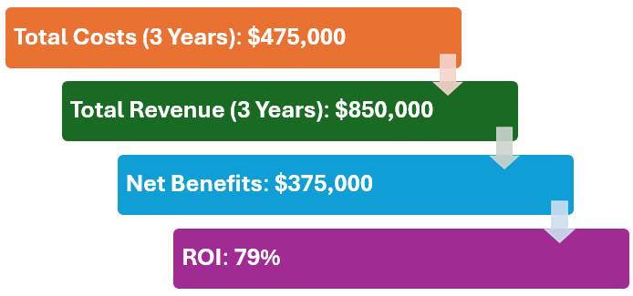


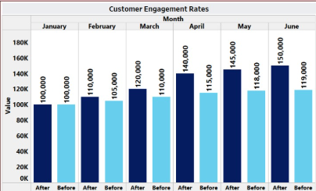
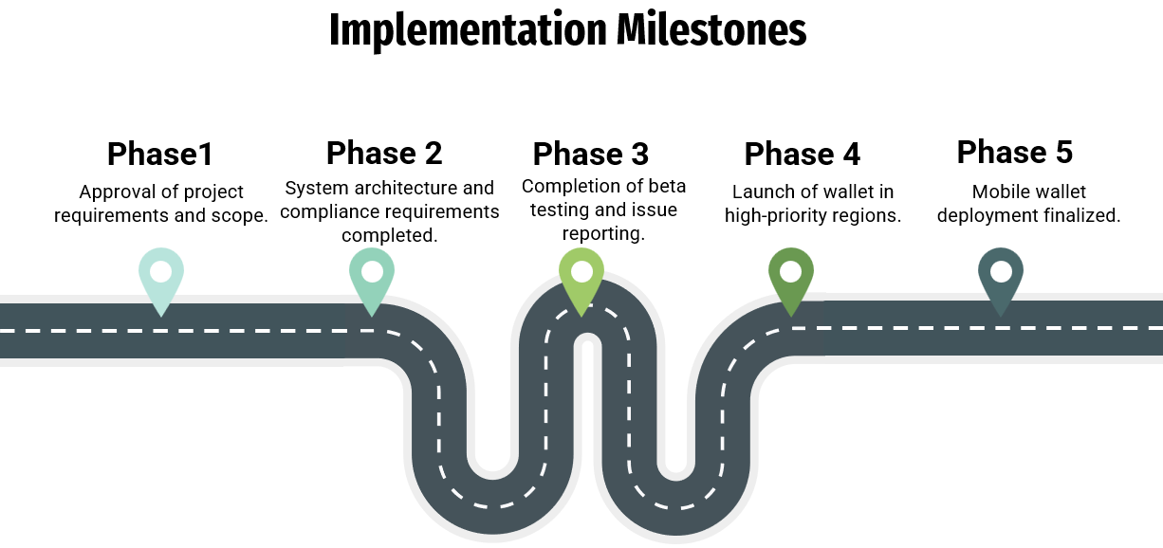
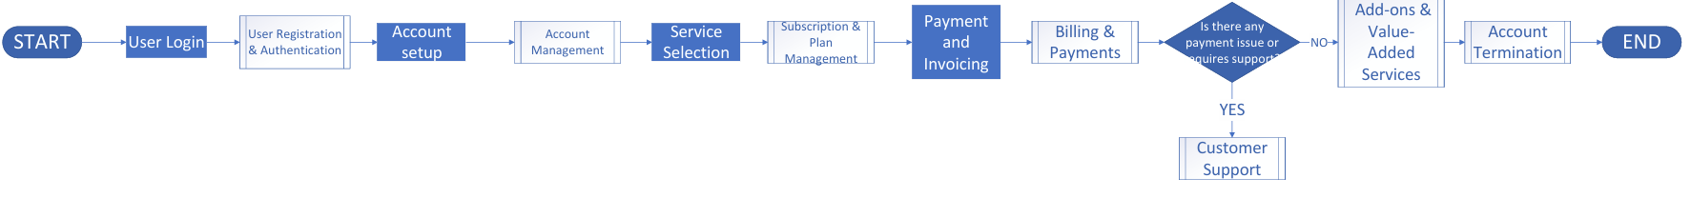
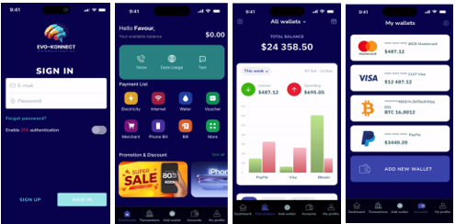
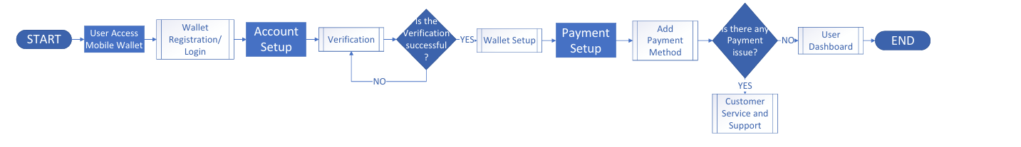
Evo-Konnect Mobile Wallet Integration: A Step Towards Seamless Digital Payments
Group 4: Favour Ukaegbu | Ashiyana Patel | Sandra Okoye | Het Modi | Vrishin Patel | Ashish Manu
Stakeholder: Elsie Emukoro
INTRODUCTION
MATERIALS & METHODS
RESULTS
ROI
Evo-Konnect is an innovative mobile wallet solution designed to streamline financial transactions and enhance customer engagement. With a focus on security, usability, and rewarding customer loyalty, Evo-Konnect aims to provide a seamless and efficient payment experience for its users.
PAIN POINTS
IMPLEMENTATION PLAN
RISK MATRIX
Likelihood | Severity | Risks | Mitigations
High | High | Data security vulnerabilities during transactions | Implement robust encryption and conduct regular audits.
Medium | Medium | Delays in vendor updates | Engage multiple vendors to reduce dependency.
Low | Low | Cosmetic bugs that do not affect functionality | Perform thorough UI testing before release.
Complex User Journey
Security Concerns
Dependence on Third-Party Systems
Limited Loyalty Mechanisms
CURRENT STATE
APPLICATION
RECOMMENDATIONS
Implement a secure and Feature rich Mobile wallet.
Enhance Customer retention with loyalty programs.
Continuously gather feedback to improve features.
Educate customers about wallet features and benefits.
FUTURE STATE

